Slide 1
Criminal Psychology
Colton Michaelis
CIS 1020
Notes:
Hello, My name is Colton Michaelis
Today im going to talk about Criminal Psychology
Television shows like Criminal Minds and the Mentalist are famous for using the Criminal Psychology in there shows.

Slide 2
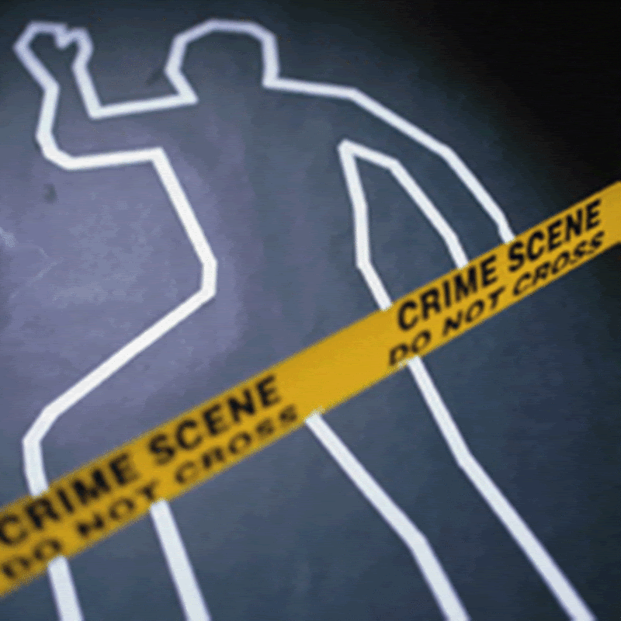
What Happened?
Who Did It?
Why Did They Do It?
Notes:
The police were called to a murder scene: on the scene the find a lady who had been shot three times in the chest.

Slide 3
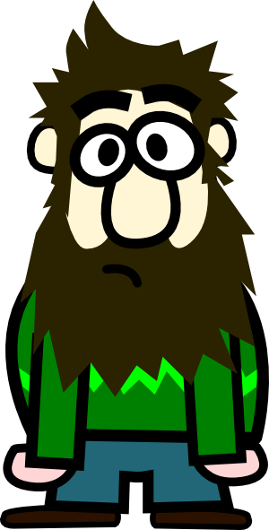
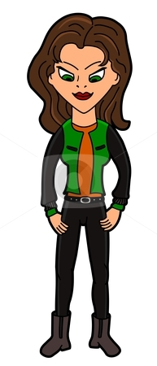
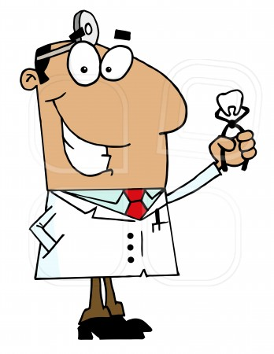
WHO DID IT??
Was it Him?
Was it Her?
How about Him?
Notes:
The police have brought in three individuals in for questioning about the murder.
We will come back to these three suspects in a min but first I’d like to talk about what Criminal Psychology is:

Slide 4
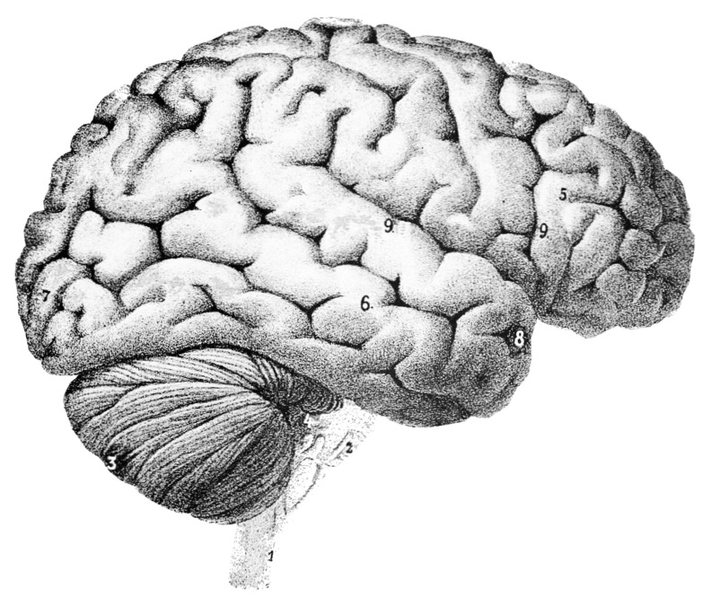
Criminal Psychology
it is the study of the wills, thoughts, intentions and reactions of criminals.
They look deeply into what makes someone commit a crime and what reactions that have after they commit it.
Notes:
it is the study of the wills, thoughts, intentions and reactions of criminals.
They look deeply into what makes someone commit a crime and what reactions that have after they commit it.
So they look into all these different things that can affect us in our lives and then they narrow it down for the police to find the correct killer.

Slide 5
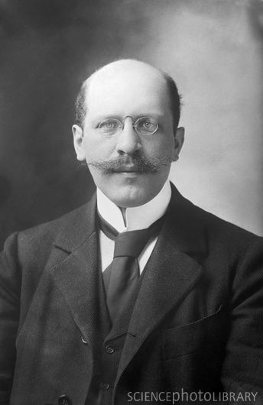
Hugo Munsterberg (1863 to 1916)
German Psychologist
Attributed to actually having truly started the field of Criminal Psychology.
Notes:
Read what's on the slide.
History of Criminal Psychology: has been around since 1800’s, the task of understanding human behavior & the mind, including that of criminals.
In 1880 two physicans used clues from the several crime scenes to predict what type of personality the serial killer jack the ripper had!

Slide 6
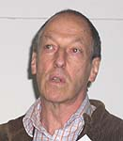
David Canter
Psychologist in the 1990’s
Founded the field of investigative psychology in Britain.
Notes:
Read what's on the slide

Slide 7
Profiling:
Is a process of identifying things in a individual.
  Personality
  Traits
  Behavior Tendencies
  Geographical locations
  Biological traits
Notes:
Criminal Psychologist use a technique called profiling, they find and look at individuals personality, traits, behavior tendices, geographical regions and biological traits.
they are often called up as witnesses in court to help the jury and judge come to a understanding the minds of the criminal.
The technique of profiling is a huge benefit for the police involeded because it allows them to look for people that fit a into specific group, instead searching all types of people.

Slide 8
Suspect one!
He's 56 yrs. of age
Jobless
Lost his job due to his addiction to pornography.
Addicted to drugs and will do anything to get them.
Criminal record
Arson & Assault with a weapon
Did 5 yrs. in jail.
Notes:
Remember the Pictures of the people at the beginning ? Well after the psychologist and police did there question they have come up with the peoples stories.
Read what’s on the slide.

Slide 9
Suspect 2
26 yrs. old
‘single mother of two children
Works two jobs to support her kids.
Loves to party
Anger problems
Criminal Record
2 DUI’s
Sentenced to 6 months community services
Ex husband has restrain order against her.
Notes:
Read what’s on the slide.

Slide 10
Suspect 3
46 yrs. old
Very successful Dentist
Recently got divorced (wife cheated on him)
wife says it was due to his addiction to pornography.
Blames his wife for his addiction
Criminal Record
None.
Notes:
Read what’s on the slide.

Slide 11
The murderer is????
Notes:
Ask the class if they have any guess on who committed the crime?
He admit to the killing of the young lady. He says that , they got into argument over dinner, she left him at the restaurant and she started to walk home. In his anger he ran to his house and grabbed his gun and shot her three times in the chest. He’s sentenced life In prison.

Slide 12
Bibliography
Http://en.wikipedia.org/wiki/offender_profiling
Http://en.wikipedia.org/wiki/criminal_Psychology
_History of Criminal Psychology_ Feb 12, 2011_Brittany Olivares
  Http://helpingpsychology.com/a_history_of_criminal_psychology

